Slide 1
Daily Review
Quantitative observations have a quantity and can be measured. They can be given a numerical value and units of measurement.
Qualitative observations are a description – they do not use numbers. Qualitative observations are made using your senses.
Create the following table on your whiteboard:
Quantitative Observations | Qualitative Observations

Slide 2
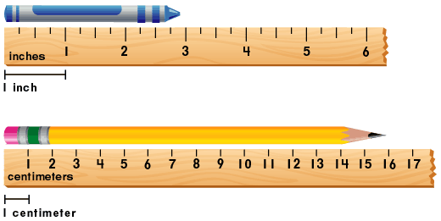
Daily Review
Write at least one quantitative observation and one qualitative observation for the following pictures. Use full sentences and units (where necessary).
centimetres
Reminder:
Quantitative observations are measurements Qualitative observations are descriptions

Slide 3
Measurement Skills Year 7 Science

Slide 4
Learning Objectives
CFU
Which four pieces of equipment are we learning to use today?
Correctly use and read measuring equipment, including rulers, thermometers, measuring cylinders, and balances.
Activate Prior Knowledge
We use tools to measure all sorts of things: length, weight, temperature, amounts of solids or liquids, and much more.
With the person next to you, list as many measuring tools as you can think of that you might find in your house.
Hint: there’s probably a whole lot of them in the kitchen!

Slide 5
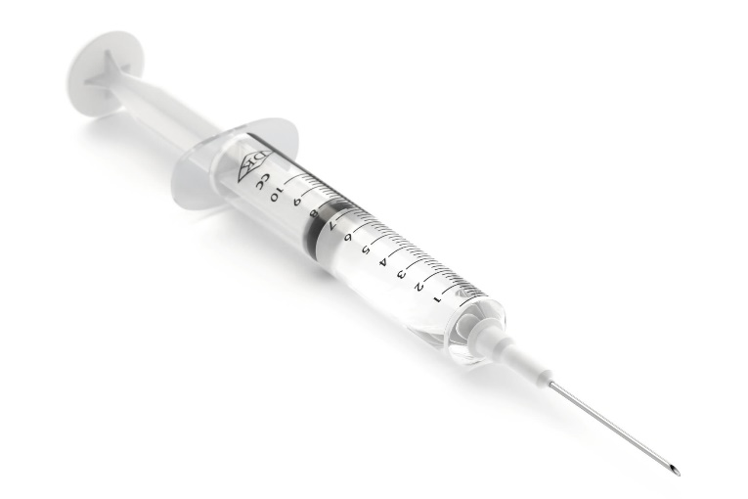
Concept Development
CFU 1
What might happen if you use measuring equipment incorrectly?
Just like Bunsen burners, there is a right way (and a wrong way!) to use measuring equipment.
If you use measuring equipment incorrectly, the measurements you make in your experiments will not be accurate.
If your measurements are inaccurate, the results of your experiments can’t be trusted… or worse!
CFU 2
Think, Pair, Share: think of a situation in which measuring incorrectly could be very dangerous. Hint: doctors, pharmacists (chemists), builders, and architects all need to measure things very carefully…

Slide 6
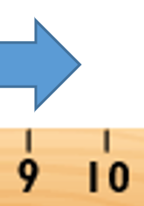


Skill Development
CFU 1
Which line tells you the length of your object?
Rulers
When measuring with a ruler, you just need to remember two simple rules:
always start from zero, and
only use the closest line: don’t guess!
For example:
CFU 2
starting from 0
9.7cm seems like a good guess… can we use it? Why or why not?
centimetres
closest line is 10, so we say that this arrow is 10cm long
only use the closest line!

Slide 7
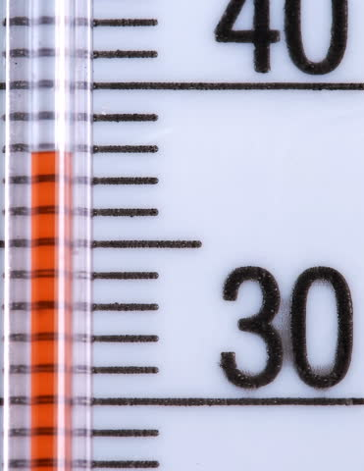

Skill Development
CFU 1
How should you look at your thermometer when reading it?
Thermometers
When measuring with a thermometer, there are also two simple rules:
always read the thermometer at eye level, and
only use the closest line: don’t guess!
For example:
CFU 2
Would it be correct to read this thermometer as 40°C? Why or why not?
closest line is 38, so we say that the temperature is 38°C
thermometer at eye level
always read at eye level!
Notes:
The numbering on our thermometers can be confusing for some students – now would be a good time to discuss it.

Slide 8
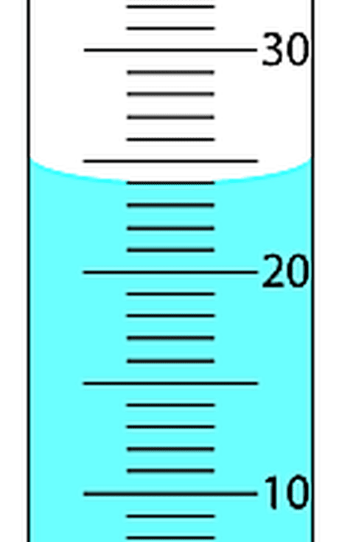
Skill Development
CFU 1
How should you look at your measuring cylinder when reading it?
Measuring Cylinders
When measuring with a measuring cylinder, there are another two simple rules:
always read the measuring cylinder at eye level, and
only use the closest line to the bottom of the meniscus.
For example:
CFU 2
What volume would you get if you read from the top of the meniscus?
closest line is 24, so we say that we have 24mL of liquid
bottom of meniscus at eye level
always read the bottom of the meniscus!
Vocabulary
men·is·cus (noun) the curved surface of a liquid in a round container

Slide 9
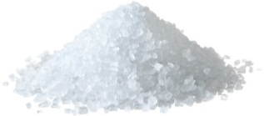


Skill Development
CFU 1
What should you do if your balance is wobbly?
Balances
When measuring with a balance, there are… you guessed it… two simple rules:
always make sure that the balance is flat, and
always press the Zero button before adding what you want to weigh.
For example, to weigh some salt:
CFU 2
Which button do you need to press before adding what you want to weigh?
CFU 3
When do you press the Zero button?
0.0
19.6
0.0
11.7
Balance is flat and doesn’t wobble
Place container on balance, press Zero
Add and weigh your substance
Notes:
At this point it would be helpful to have a balance and show the students the adjustable feet and the spirit level (at least; you could demo the whole process, or ask a student to help you do so).

Slide 10
Relevance
If you use measuring equipment incorrectly, the measurements you make in your experiments will not be accurate, making your experiment unreliable.
Measurement is an important skill in many jobs.
Measurement errors can affect the safety and health of people.

Slide 11
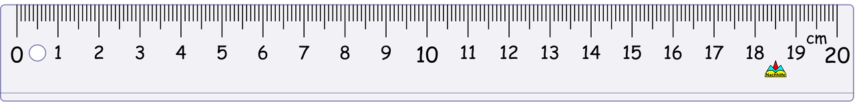
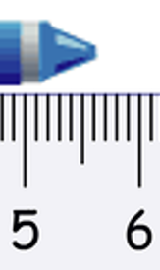
Skill Closure
This the not correct way to use a ruler. What is incorrect about it?
Roger moved the end of the crayon to zero, then looked closely at the tip. This is what he saw. What should he write down as the length of the crayon? (A line has been added to help you.)

Slide 12
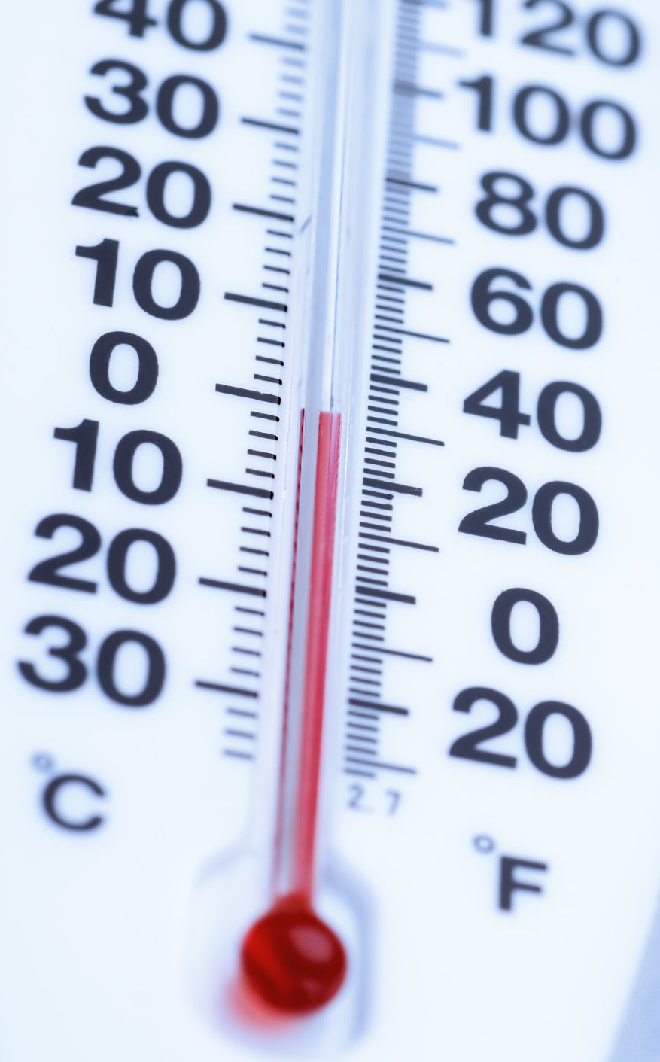
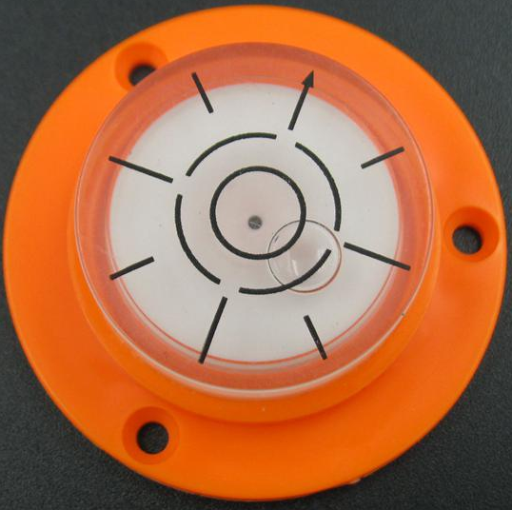
Skill Closure
Felicity is feeling lazy and doesn’t want to get out of her seat to read this thermometer. How is this going to affect her measurement, and why?
Todd puts his balance down on his bench and notices that his spirit level looks like this. What does he need to do before using the balance?

Slide 13
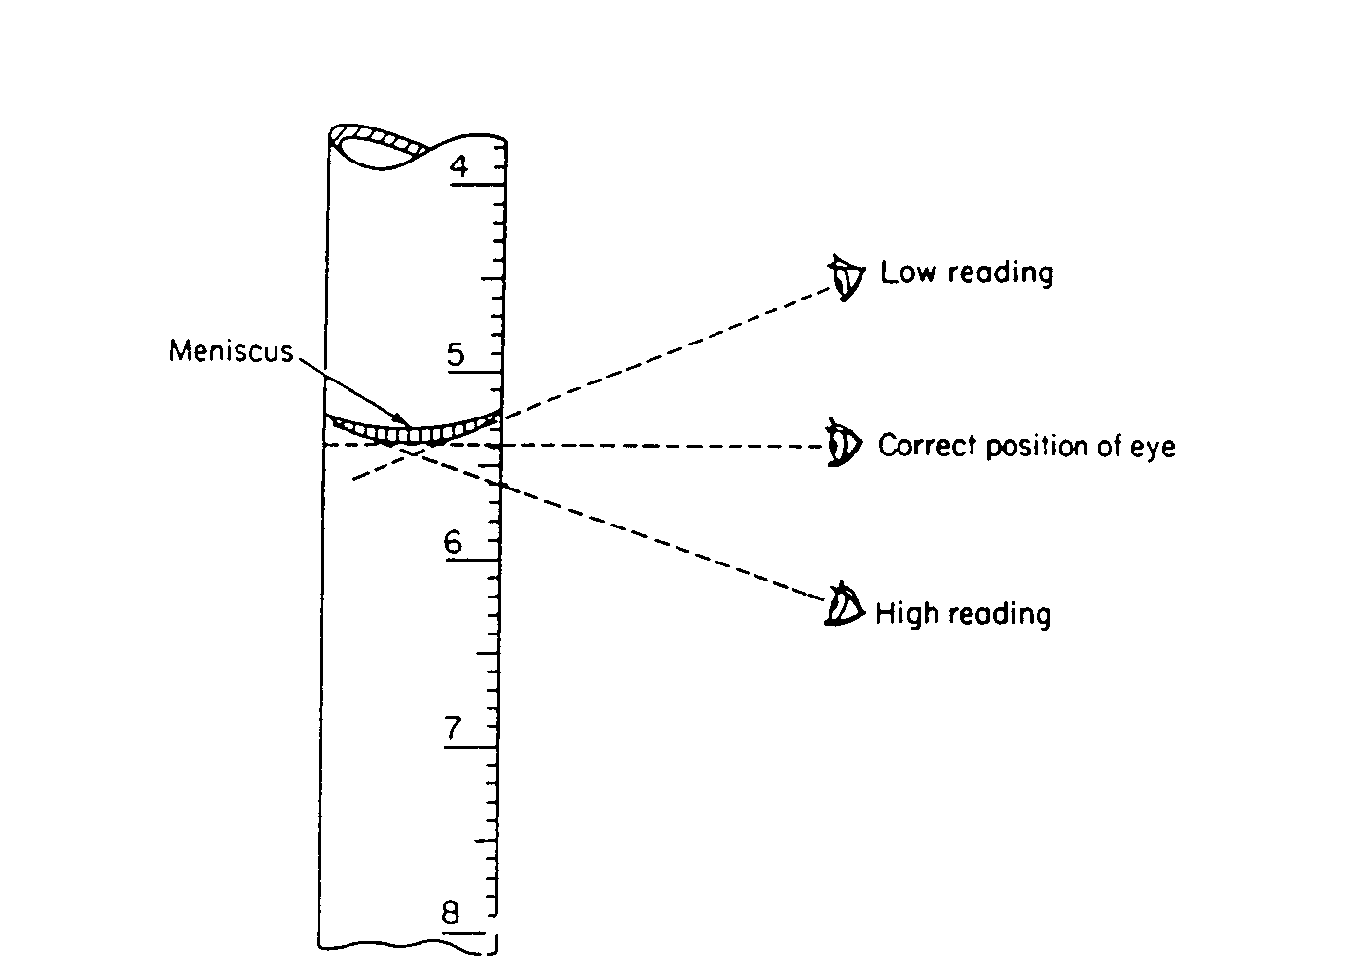
Skill Closure
Which of these four eyes is reading the measuring cylinder correctly?
b
a
c
d
Notes:
Fun trick: wait until the end of the slide to point out that the numbers are going the wrong way (for a measuring cylinder)

Slide 14
Independent Practice
Reminders:
Only use the closest lines: don’t guess or make up extra numbers. Always read thermometers and measuring cylinders at eye level. Measuring cylinders are read at the bottom of the meniscus (curve at the top of the liquid). Make sure your balance is flat before using it.
Rule up a new page and title it “Measurement Tasks”.
Use your rulers and the equipment around the classroom to answer the following questions. Use full sentences.
How wide is your desk?
How thick is your desk?
What is the air temperature in the classroom?
What is the temperature of the water that comes out of the taps?
How heavy is your pencil case?
How heavy is the blue liquid in the jars (not including the weight of the jar itself)?
Hint: the empty jars might come in handy for this one…
What volume of liquid is in each of the measuring cylinders?
Notes:
To save on setup, this activity reuses the blue liquid / empty jars (Q6) and the measuring cylinders with vinegar in them (Q7) from the Observations lesson.
Meter rulers will be necessary for Q1.

